Slide 1
Pattern Recognition
Yukyung Choi
yk.choi@rcv.sejong.ac.kr

Slide 2
Summary
Decision Tree & Random Forests I
Hand on Labs: Data Classification using library
Decision Tree & Random Forests II
Hand on Labs: Implementation of DT-RF

Slide 3
Today’s Lecture
Definition of Decision Tree
Introduction to Decision Tree
Random Forest
Hand on Labs

Slide 4
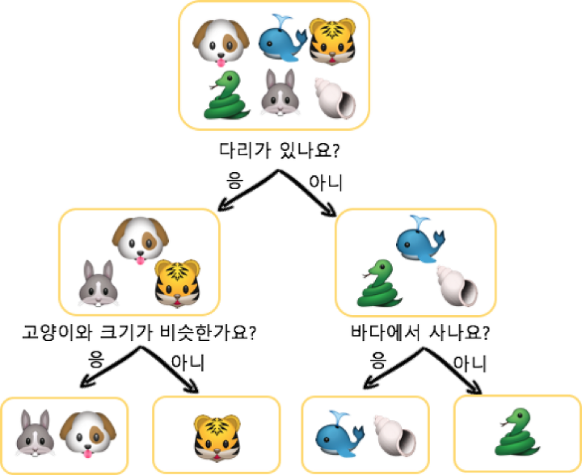
What is a Decision Tree?
Definition
A decision tree is a decision support tool that uses a tree-like graph

Slide 5
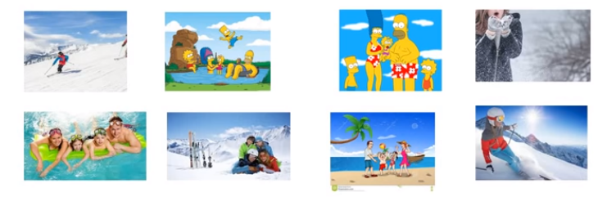
How Decision Tree works

Slide 6
How Decision Tree works
How do you teach your baby to pick winter family vacation photo?

Slide 7
How Decision Tree works
You may say to consider snow, human, and the number of members

Slide 8
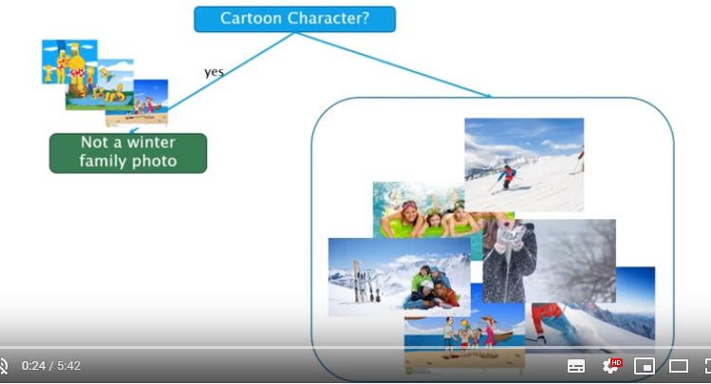
How Decision Tree works
We definitely know the cartoon is not a family photo

Slide 9
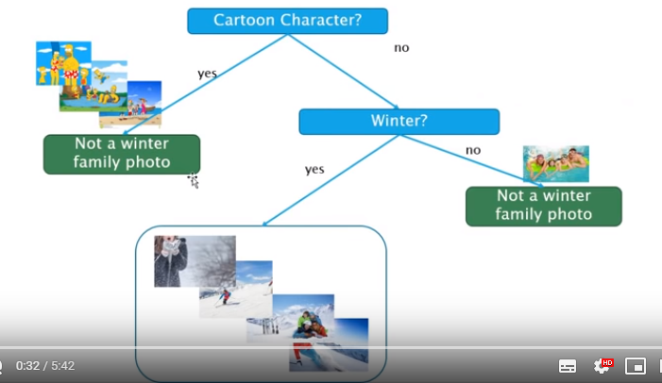
How Decision Tree works
We definitely know summer is not a winter photo

Slide 10
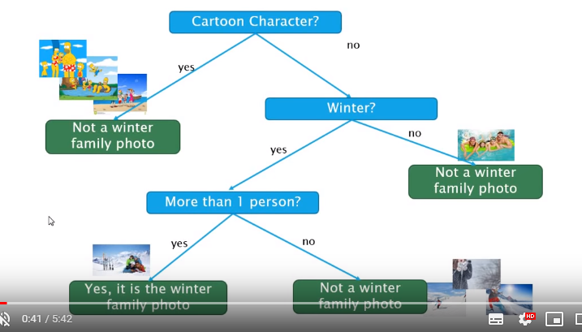
How Decision Tree works
We know family photo has more than 1 person

Slide 11
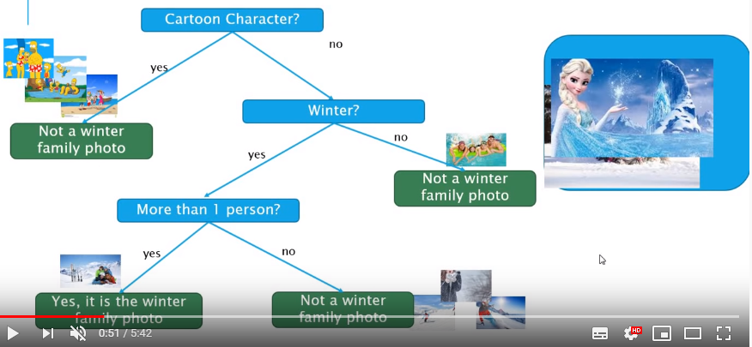
How Decision Tree works
Now, your baby can recognize more pictures using this decision tree ☺

Slide 12
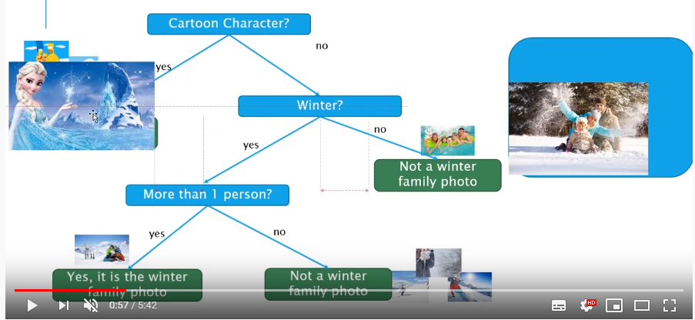
How Decision Tree works
Now, your baby can recognize more pictures using this decision tree ☺

Slide 13
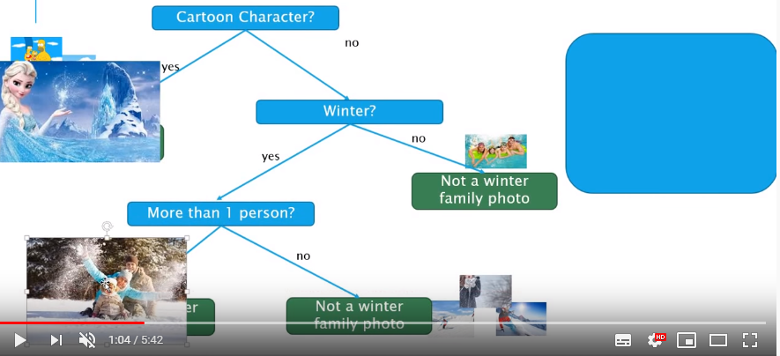
How Decision Tree works
Now, your baby can recognize more pictures using this decision tree ☺

Slide 14
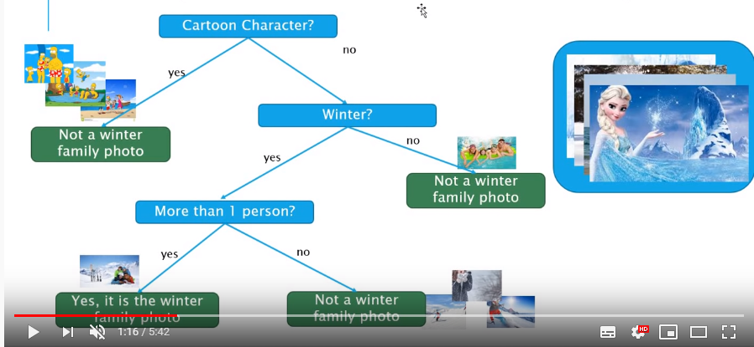
How Decision Tree works
Yes, the baby is the machine, and the machine learned from you

Slide 15
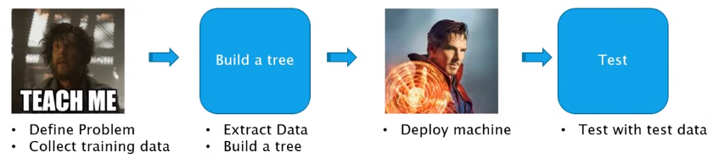
Decision Tree, two main concepts

Slide 16
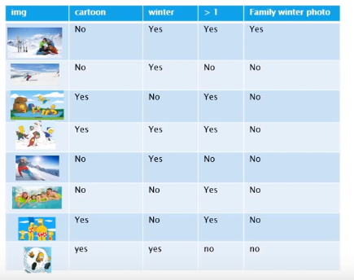
Build a Decision Tree: Extract training data

Slide 17
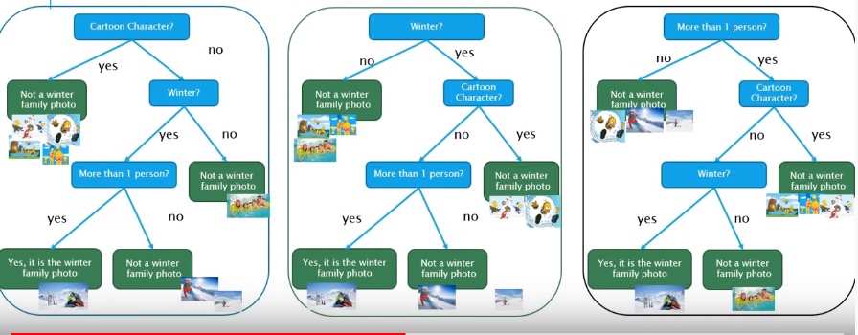
Build a Decision Tree

Slide 18
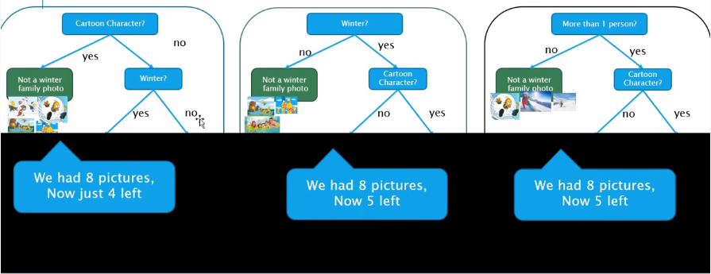
Build a Decision Tree
Choose best feature to split

Slide 19
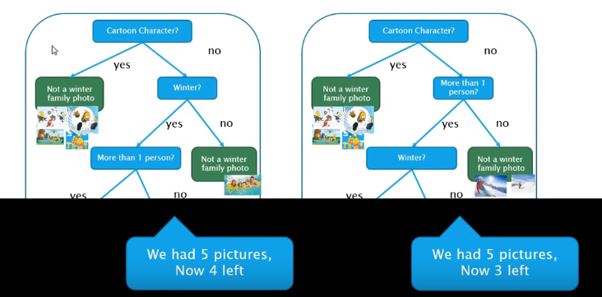
Build a Decision Tree
Choose best feature to split

Slide 20
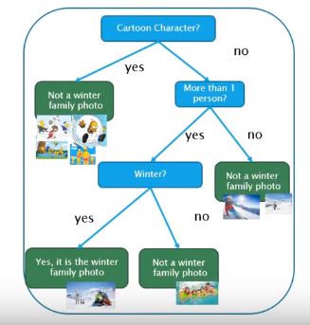
Build a Decision Tree
Choose best feature to split

Slide 21
Terminologies
Entropy
Information Gain

Slide 22
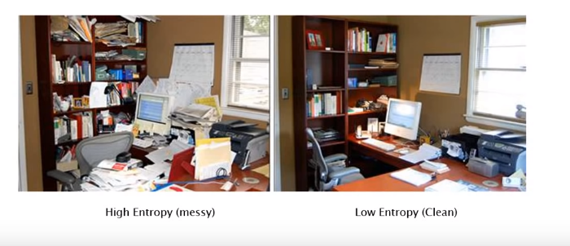
Terminologies
Entropy

Slide 23

Terminologies
Entropy: measure of messiness

Slide 24
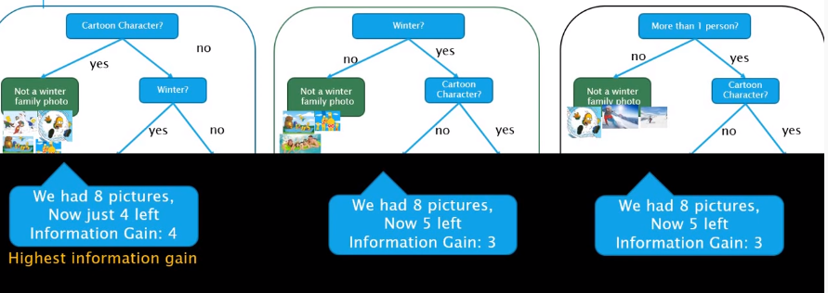
Terminologies
Information Gain: Base entropy – New entropy

Slide 25
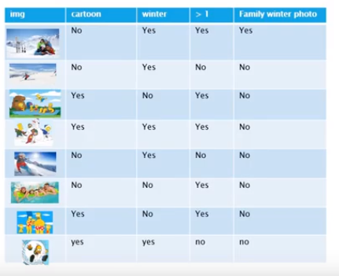
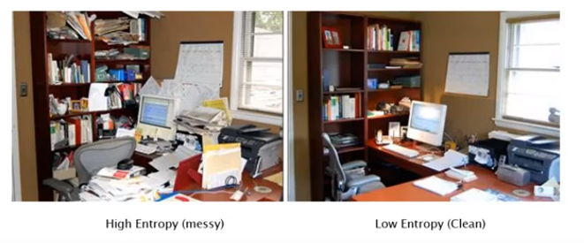
ID3 Algorithm
Entropy and Information Gain

Slide 26
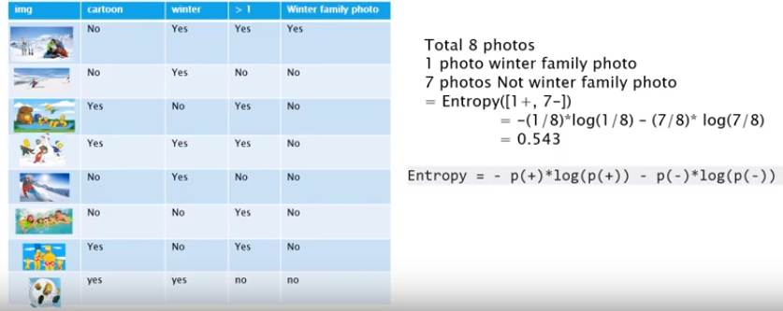
ID3 Algorithm
Calculate Entropy to find family photo of 8 photos
Before Decision Tree Building

Slide 27
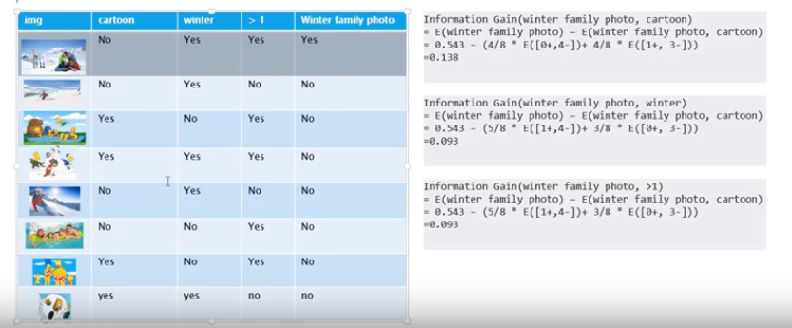
ID3 Algorithm
Information Gain
Decrease in entropy after a dataset is split on an attribute

Slide 28
Random Forests
Random forests or random decision forests are an ensemble learning method for classification, regression and other tasks that operates by constructing a multitude of decision trees

Slide 29
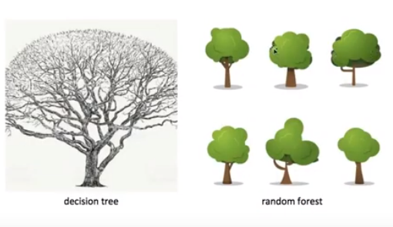
Decision Tree vs. Random Forests

Slide 30
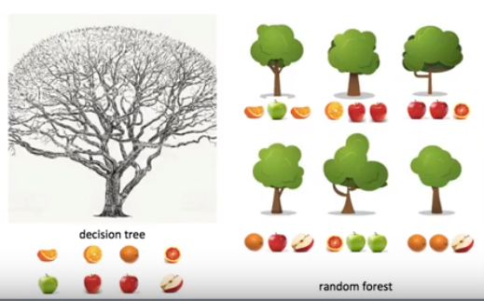
Decision Tree vs. Random Forests
Apple, orange classifier

Slide 31
Decision Tree vs. Random Forests
Boosting: biased data collection (➔ 중복 데이터 허용)

Slide 32
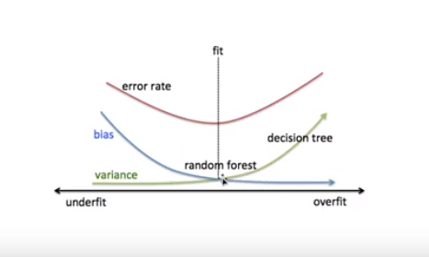
Decision Tree vs. Random Forests
Avoid Overfitting

Slide 33
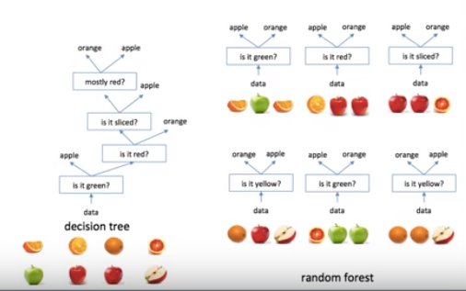
Decision Tree vs. Random Forests
“Random selection” of feature set instead of “best selection”
가장 좋은
질문을
먼저 해야 한다
질문이
랜덤으로
셀렉션
된다

Slide 34
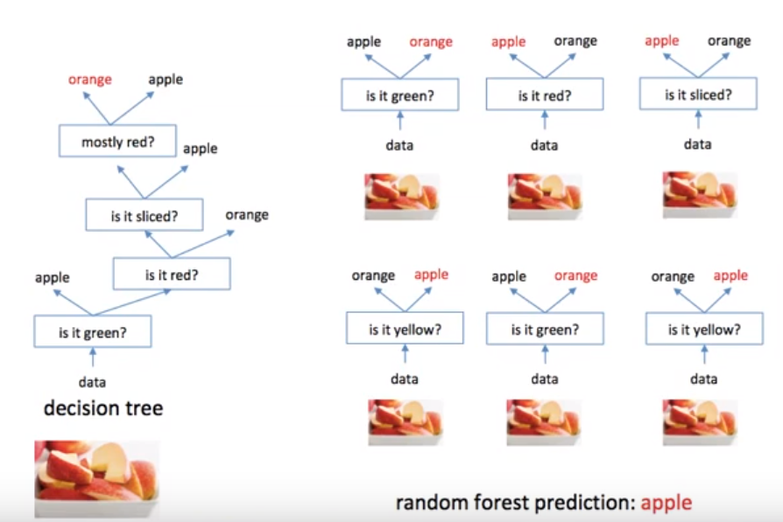
Decision Tree vs. Random Forests
Aggregating of result (voting)

Slide 35
Reference
[머신러닝] 의사결정트리 (Decision Tree) 알고리즘 쉽게 이해하기
[머신러닝] 의사결정트리 (Decision Tree) - ID3 알고리즘 수학적 접근
[머신러닝] 랜덤포레스트

